Slide 1
Container Orchestration

Slide 2

Everyone’s container journey starts with one container….

Slide 3
At first the growth is easy to handle….

Slide 4
But soon you have many applications, many instances…

Slide 5
And that is why we have Container orchestration

Slide 6
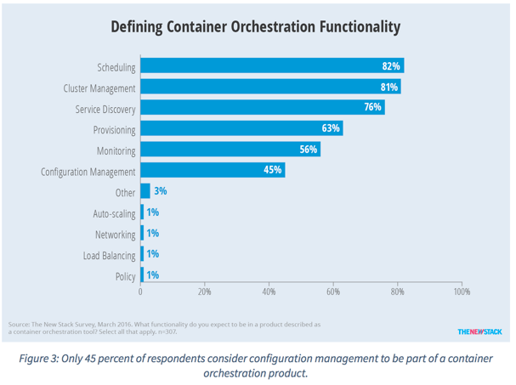
Container Orchestration Responsibilities
Container orchestration
Scheduling
Cluster management
Service discovery
Related functionality
Provisioning
Monitoring
Configuration management

Slide 7


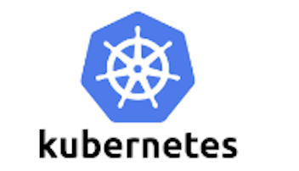





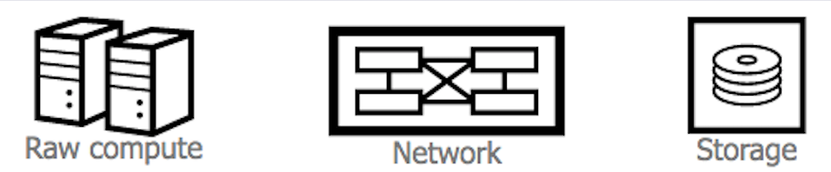
Container Ecosystem Layers
Layer 6
Development Workflow
Opinionated Containers
Layer 5
Orchestration/Scheduling
Service Model
Layer 4
Container Engine
Layer 3
Operating System
Layer 2
Virtual Infrastructure
Layer 1
Physical Infrastructure

Slide 8
What is container orchestration?
Container orchestration
Manages the deployment, placement, and lifecycle of workload containers
Cluster management
Federates multiple hosts into one target
Scheduling
Distributes containers across nodes
Service discovery
Knows where the containers are located
Distributes client requests across the containers
Replication
Ensures the right number of nodes and containers
Health management
Replaces unhealthy containers and nodes
Container Orchestrator
Manager
Image Repository
Scheduler
Discovery DB
Replicator
Node
Node
Node
Daemon
Daemon
Daemon
Containers
Containers
Containers

Slide 9
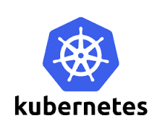

Container Orchestration in Bluemix
In June 2015 when IBM Bluemix Container Service launched, open source orchestration projects were not available for production
Kubernetes – July 21, 2015
Docker Swarm – November 3, 2015
Apache Mesos – July 27, 2016
IBM developed custom orchestration to ensure anti co-location of containers within a group and container placement to the least utilized hosts
IBM Research runs rigorous performance and scalability testing (https://github.com/Open-I-Beam/containers-os) on various open source projects; then work with those communities to make improvements

Slide 10
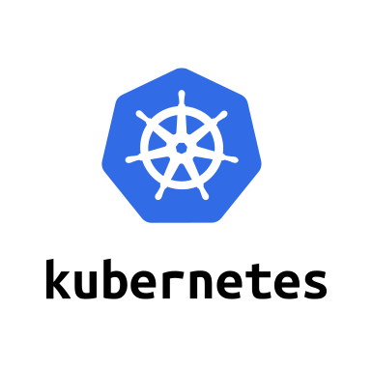
Introduction to Kubernetes

Slide 11
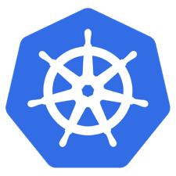
What is Kubernetes?
Container orchestrator
Runs and manages containers
Unified API for deploying web applications, batch jobs, and databases
Maintains and tracks the global view of the cluster
Supports multiple cloud and bare-metal environments
Manage applications, not machines
Rolling updates, canary deploys, and blue-green deployments
Designed for extensibility
Rich ecosystem of plug-ins for scheduling, storage, networking
Open source project managed by the Linux Foundation
Inspired and informed by Google's experiences and internal systems
100% open source, written in Go

Slide 12
Kubernetes Strengths
Kubernetes has a clear governance model managed by the Linux Foundation. Google is actively driving the product features and roadmap, while allowing the rest of the ecosystem to participate.
A growing and vibrant Kubernetes ecosystem provides confidence to enterprises about its long-term viability. IBM, Huawei, Intel, and Red Hat are some of the companies making prominent contributions to the project.
The commercial viability of Kubernetes makes it an interesting choice for vendors. We expect to see new offerings announced over the next several months.
Despite the expected growth in commercial distributions, Kubernetes avoids dependency and vendor lock-in through active community participation and ecosystem support.
Kubernetes supports a wide range of deployment options. Customers can choose between bare metal, virtualization, private, public, and hybrid cloud deployments. It enjoys a wide range of delivery models across on-premises and cloud-based services.
The design of Kubernetes is more operations-centric than developer-orientated, which makes it the first choice of DevOps teams.

Slide 13
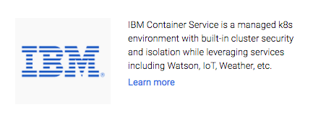
Kubernetes Certified Service Providers (KCSP)
The KCSP program is a vetted tier of service providers who have deep experience helping enterprises successfully adopt Kubernetes. KCSP partners offer Kubernetes support, consulting, professional services and training for organizations embarking on their Kubernetes journey.
KCSP is managed by the Cloud Native Computing Foundation
IBM is a KCSP Partner

Slide 14
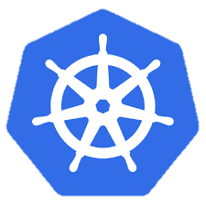
Kubernetes Cluster Architecture
internet
Master node
Node that manages the cluster
Scheduling, replication & control
Multiple nodes for HA
Worker nodes
Node where pods are run
Docker engine
kubelet agent accepts & executes commands from the master to manage pods
cAdvisor – Container Advisor provides resource usage and performance statistics
kube-proxy – routes inbound or ingress traffic
kubectl
firewall
Kubernetes cluster
Worker node
kube-proxy
kubelet
docker
pod
pod
pod
Master node
pod
pod
pod
cAdvisor
container
container
authentication authorization
container
container
APIs
container
scheduling
actuator
REST
Worker node
kube-proxy
controller manager
kubelet
Distributed watchable storage (etcd)
docker
pod
pod
pod
pod
pod
pod
cAdvisor
container
container
container
container
container

Slide 15
Master Node Components
Etcd
A highly-available key value store
All cluster data is stored here
API Server
Exposes API for managing Kubernetes
Used by kubectrl CLI
Controller manager
Daemon that runs controllers, which are the background threads that handle routine tasks in the cluster
Node Controller – Responsible for noticing and responding when nodes go down
Replication Controller – Replaced by ReplicaSet
Endpoints Controller – Populates the Endpoints object (that is, joins services and pods)
Service Account & Token Controllers – Create default accounts and API access tokens for new namespaces
Scheduler
Selects the worker node each pods runs in

Slide 16
Kubernetes Architecture: How apps are accessed
Pod
Smallest deployment unit – runs containers
Each pod has its own IP
Shares a PID namespace, network, and hostname
Service
Collection of pods exposed as an endpoint
state and networking info propagated to all worker nodes
Types of service exposure
ClusterIP – Exposes cluster-internal IP
NodePort – Exposes the service on each Node’s IP at a static port
LoadBalancer – Exposes externally using a cloud provider’s load balancer
ExternalName – Maps to an external name (such as foo.bar.example.com)
Kubernetes components
Master Node
Worker Node 1
Pod
Pod
App A
App B
App A Client
App A Service
Worker Node 2
Pod
Pod
App B
App A
App B Client
App B Service
Worker Node 3
Pod
Pod
App A
App B

Slide 17
Deployments & ReplicaSets
Deployment
A set of pods to be deployed together, such as an application
Declarative: Revising a Deployment creates a ReplicaSet describing the desired state
Rollout: Deployment controller changes the actual state to the desired state at a controlled rate
Rollback: Each Deployment revision can be rolled back
Scale and autoscale: A Deployment can be scaled
ReplicaSet
The next-generation ReplicationController
A set of pod templates that describe a set of pod replicas
Uses a template that describes specifically what each pod should contain
Ensures that a specified number of pod replicas are running at any given time
Deployment
create
ReplicaSet 1
Deployment
rollback
rollout
ReplicaSet 1
ReplicaSet 2
rolling update
pod
pod
pod
ReplicaSet 2
svcA
svcA
svcB
Notes:
https://kubernetes.io/docs/concepts/workloads/controllers/deployment/
https://kubernetes.io/docs/concepts/workloads/controllers/replicaset/
https://kubernetes.io/docs/user-guide/kubectl/v1.6/#rollout
https://kubernetes.io/docs/user-guide/kubectl/v1.6/#rolling-update
https://kubernetes.io/docs/concepts/cluster-administration/manage-deployment/#canary-deployments
Blue-green deployment isn’t built-in to Kubernetes (as of July 2017). Some examples others have built:
https://techbeacon.com/one-year-using-kubernetes-production-lessons-learned
http://www.devoperandi.com/kubernetes-deployment-resource-bluegreen-deploys-for-everyone/

Slide 18
Kubernetes Autoscaling
Horizontal Pod Autoscaling (HPA)
Automatically scales the number of pods in a replication controller, deployment, or replica set
Matches the observed average CPU utilization to the specified target
Fetches metrics in two different ways: direct Heapster access and REST client access
Kubernetes Heapster enables container cluster monitoring and performance analysis
Default config: query every 30 sec, maintain 10% tolerance, wait 3 min after scale-up, wait 5 min after scale-down
$ kubectl autoscale deployment <deployment-name> --cpu-percent=50 --min=1 --max=10 deployment ”<hpa-name>" autoscaled
Creates a horizontal pod autoscaler
An HPA instance
Maintains between 1 and 10 replicas of the pods controlled by the deployment
Maintains an average CPU utilization across all pods of 50%
Notes:
https://kubernetes.io/docs/tasks/run-application/horizontal-pod-autoscale/
https://kubernetes.io/docs/tasks/run-application/horizontal-pod-autoscale-walkthrough/
https://kubernetes.io/docs/user-guide/kubectl/v1.6/#autoscale
https://github.com/kubernetes/community/blob/master/contributors/design-proposals/horizontal-pod-autoscaler.md

Slide 19
Naming
Name
Each resource object by type has a unique name
Namespace
Resource isolation: Each namespace is a virtual cluster within the physical cluster
Resource objects are scoped within namespaces
Low-level resources are not in namespaces: nodes, persistent volumes, and namespaces themselves
Names of resources need to be unique within a namespace, but not across namespaces
Resource quotas: Namespaces can divide cluster resources
Initial namespaces
default – The default namespace for objects with no other namespace
kube-system – The namespace for objects created by the Kubernetes system
Resource Quota
Limits resource consumption per namespace
Limit can be number of resource objects by type (pods, services, etc.)
Limit can be total amount of compute resources (CPU, memory, etc.)
Overcommit is allowed; contention is handled on a first-come, first-served basis

Slide 20
Configuring Resources and Containers
Label
Metadata assigned to Kubernetes resources (pods, services, etc.)
Key-value pairs for identification
Critical to Kubernetes as it relies on querying the cluster for resources that have certain labels
Selector
An expression that matches labels to identify related resources
ConfigMap
Configuration values to be used by containers in a pod
Stores configuration outside of the container image, making containers more reusable
Secret
Sensitive info that containers need to read or consume
Encrypted in special volumes mounted automatically

Slide 21
Kubernetes Management Architecture
UI
Master Node
Worker Node 1
Worker Node 2
API
Worker Node 3
CLI
Worker Node n
Registry
Etcd
API Server
Controller Manager Server
Scheduler

Slide 22
Kubectl Commands
Get the state of your cluster
$ kubectl cluster-info
Get all the nodes of your cluster
$ kubectl get nodes -o wide
Get info about the pods of your cluster
$ kubectl get pods -o wide
Get info about the replication controllers of your cluster
$ kubectl get rc -o wide
Get info about the services of your cluster
$ kubectl get services
Get full config info about a Service
$ kubectl get service NAME_OF_SERVICE -o json
Get the IP of a Pod
$ kubectl get pod NAME_OF_POD -template={{.status.podIP}}
Delete a Pod
$ kubectl delete pod NAME
Delete a Service
$ kubectl delete service NAME_OF_SERVICE

Slide 23
Resources
Kubernetes tutorial
https://kubernetes.io/docs/tutorials/kubernetes-basics/
Introduction to container orchestration
https://www.exoscale.ch/syslog/2016/07/26/container-orch/
TNS Research: The Present State of Container Orchestration
https://thenewstack.io/tns-research-present-state-container-orchestration/
Large-scale cluster management at Google with Borg
https://research.google.com/pubs/pub43438.html

